Slide 1
Texture and Color Distribution-based Classification for Live Coral Detection
Joshua V. Stough, Lisa Greer, Matt Benson
July 9, 2012

Slide 2
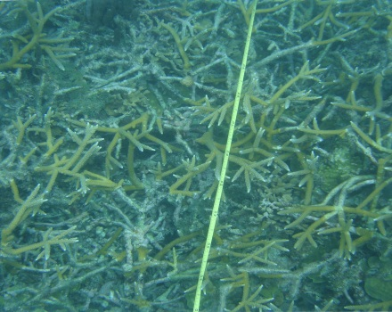
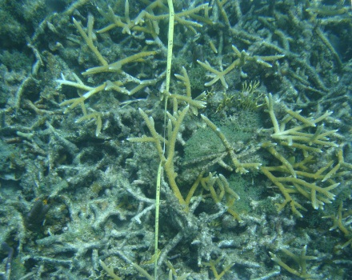
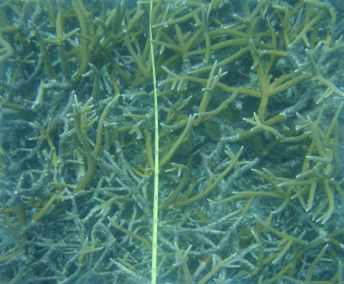
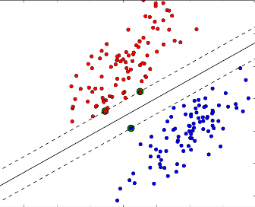
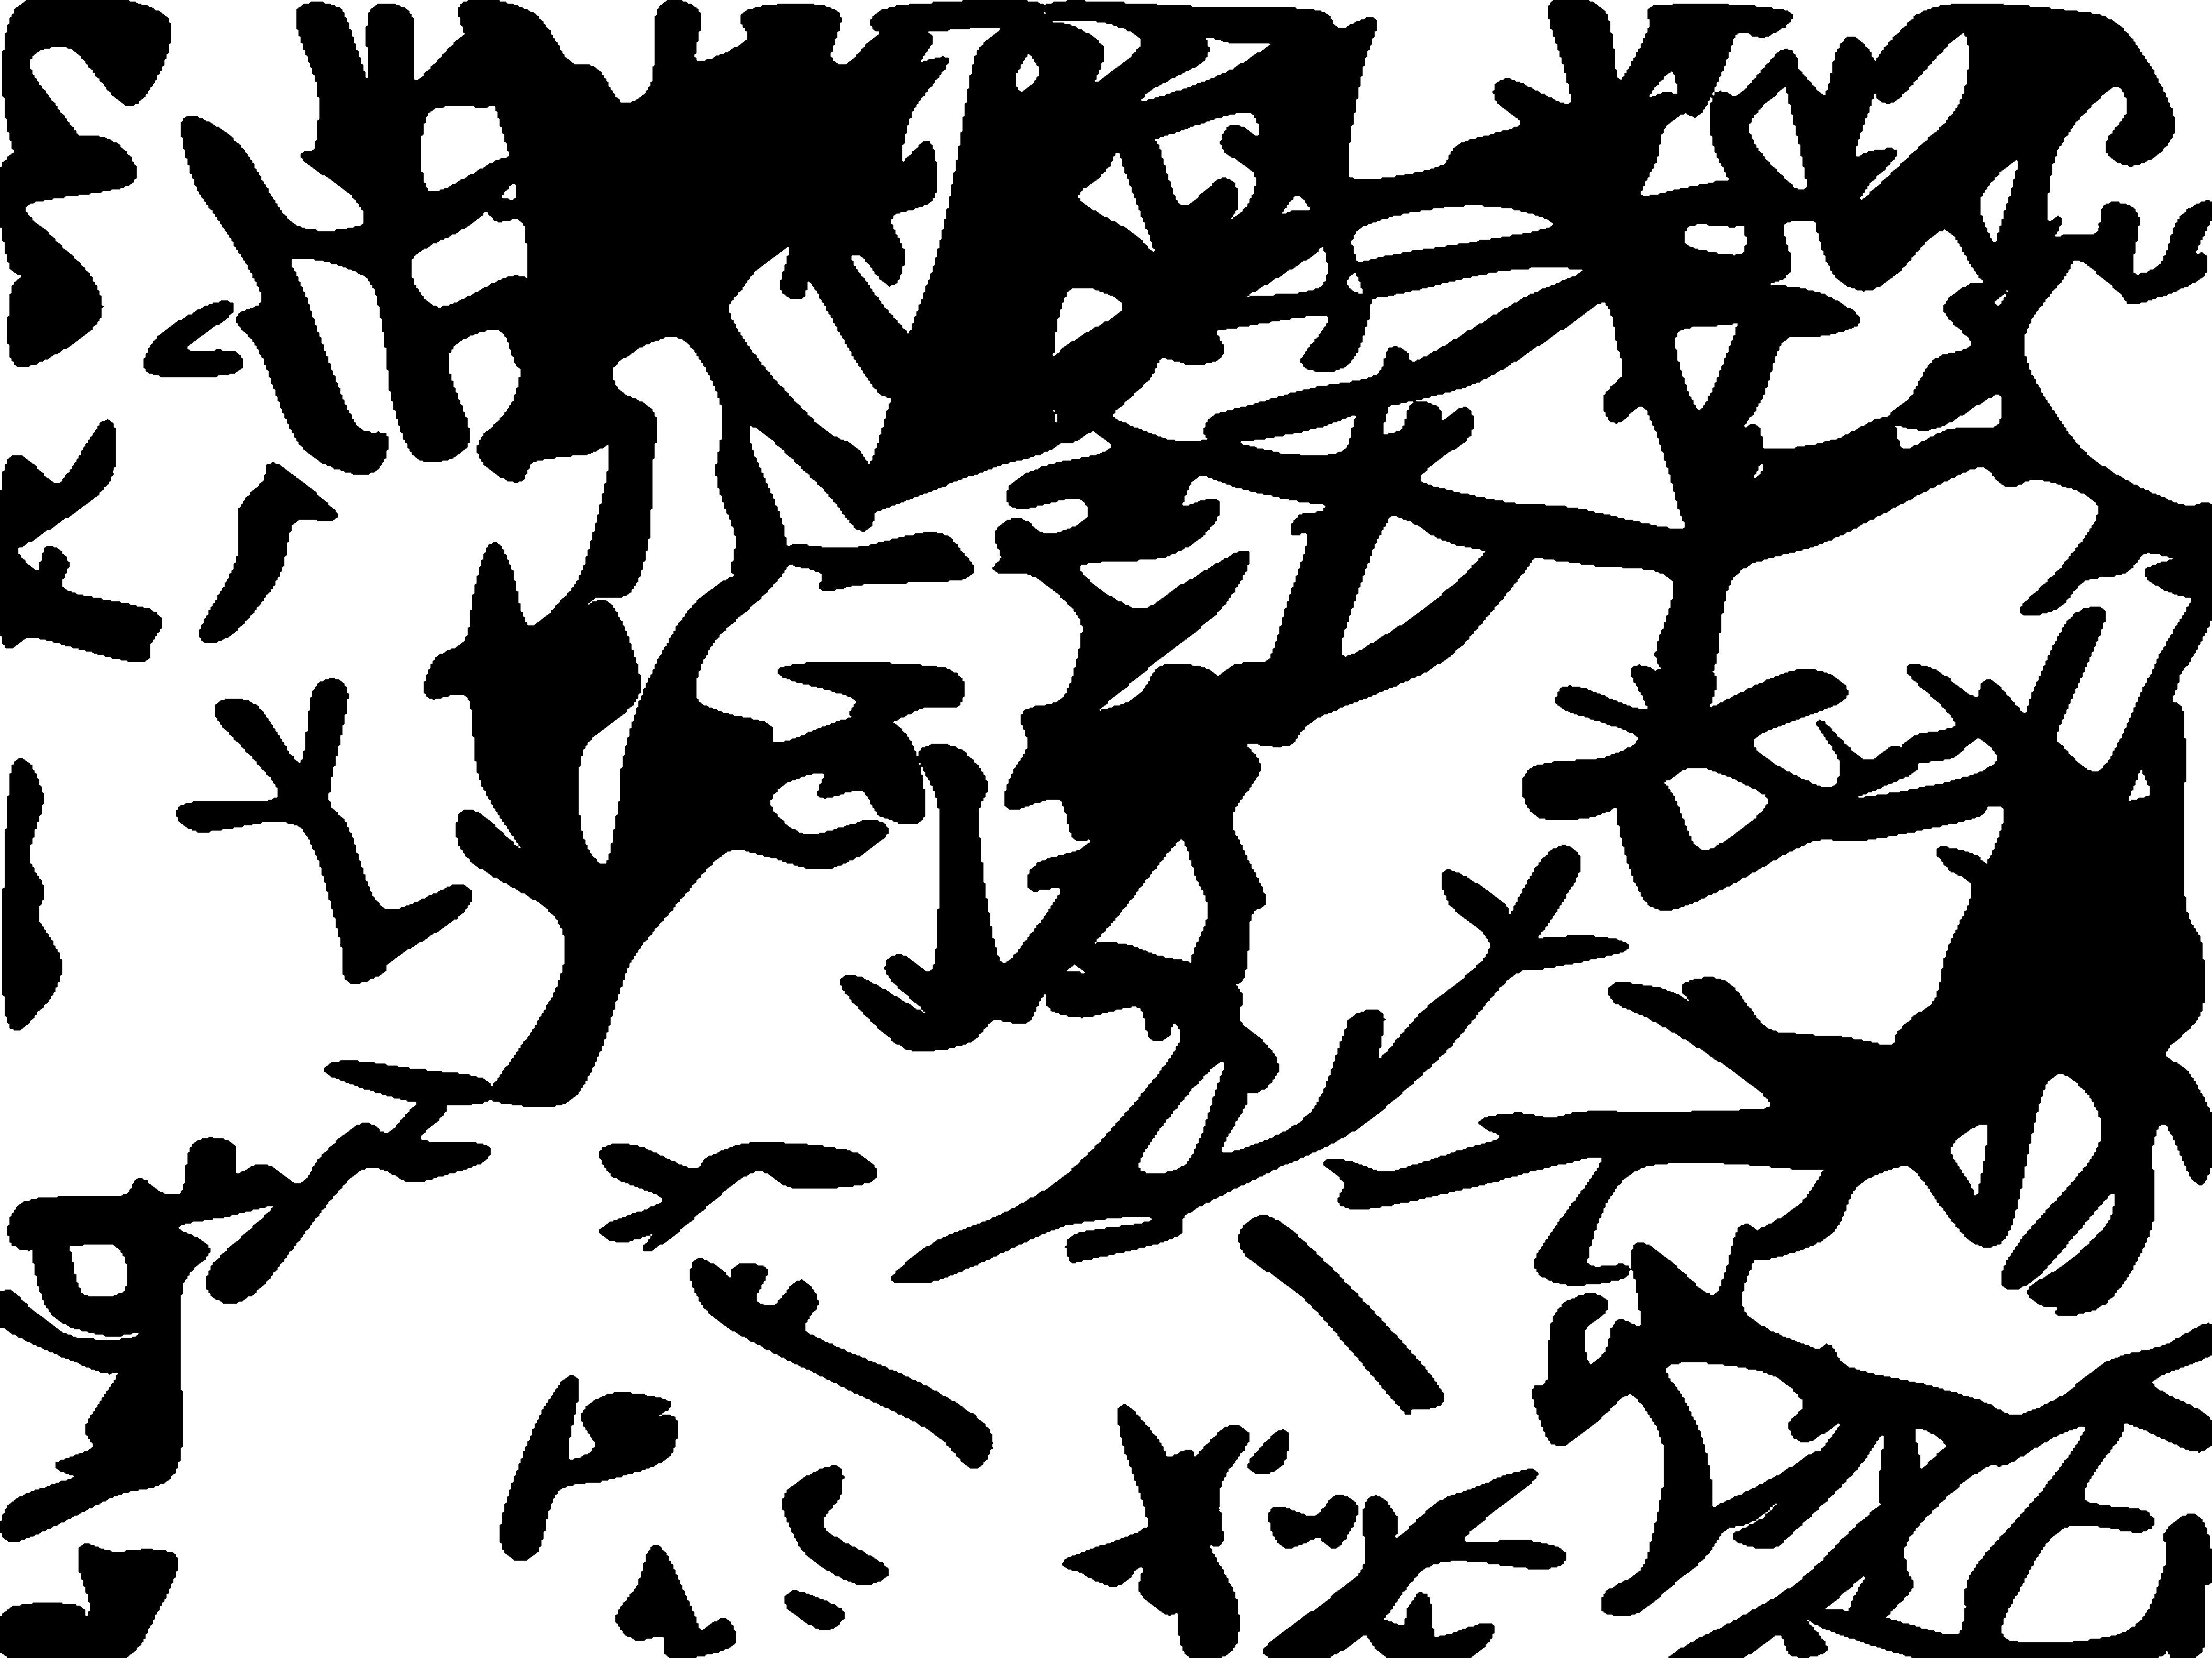
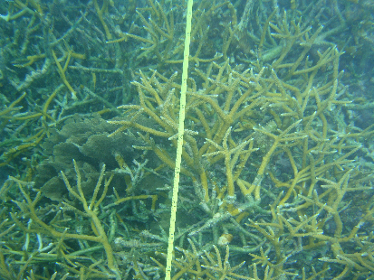
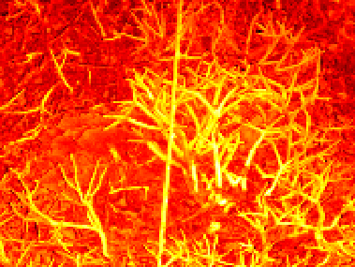
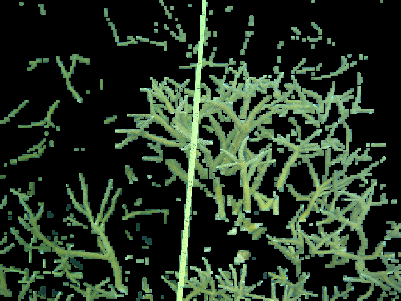
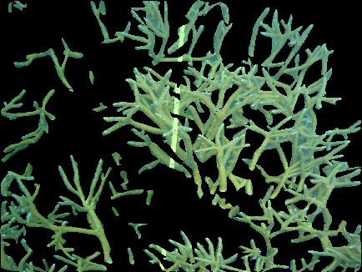
The Gist
Problem: Estimate live A. cervicornis cover
Preliminary solution: linear SVM on quantile functions
Train:
Test:

Slide 3
Prior Work
Supervised Learning
Feature types: texture, color
SIFT, GIST, GLCM – [van de Sande et al., TPAMI 2010]
Discriminating learner
Support Vector Machines – [Cortes, Vapnik, ML 1995]
Random Forests – [Criminisi 2011]
Clustering, Fisher, Gaussian Mixtures, Neural Net, ...
Coral benthic studies
NCC/LBP with NN – [Marcos et al., Optics 2005]
Filter bank response with BoW/clustering – [Purser et al., MEPS 2009], [Beijbom et al., CVPR 2012]
SVM on raw color – [Mehta et al., VISAPP 2007]

Slide 4
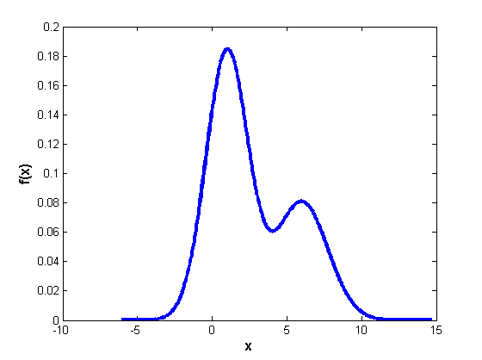
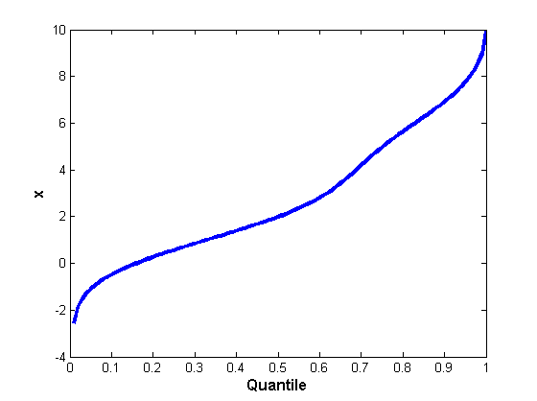
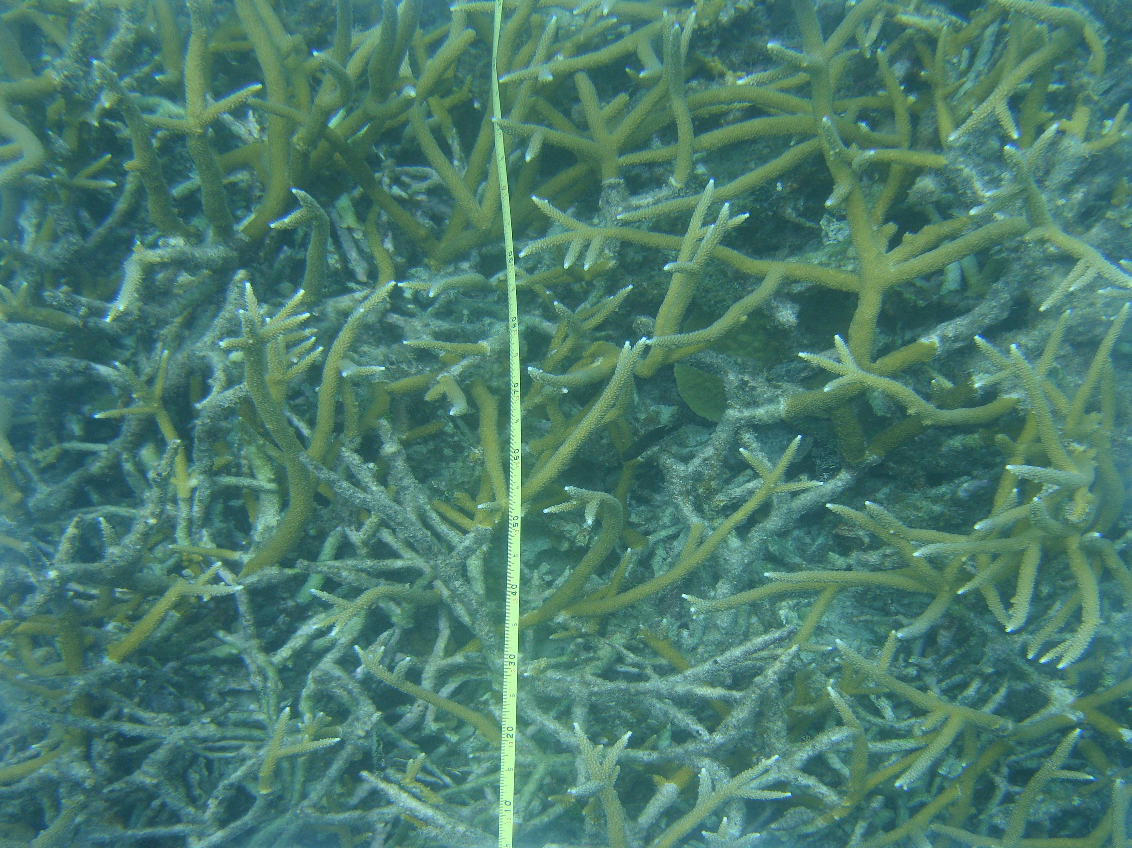
Features: Color Quantile Functions (QFs)
[Levina, UC-Berkeley 2002] [Broadhurst et al., ISBI 2006]
Inverse cumulative distribution function
Mean shift, variance scaling are linear
Computed for each color channel at local patches

Slide 5
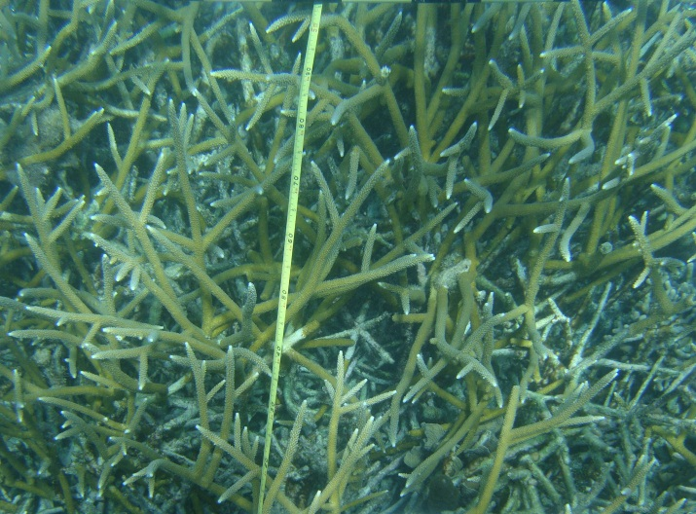
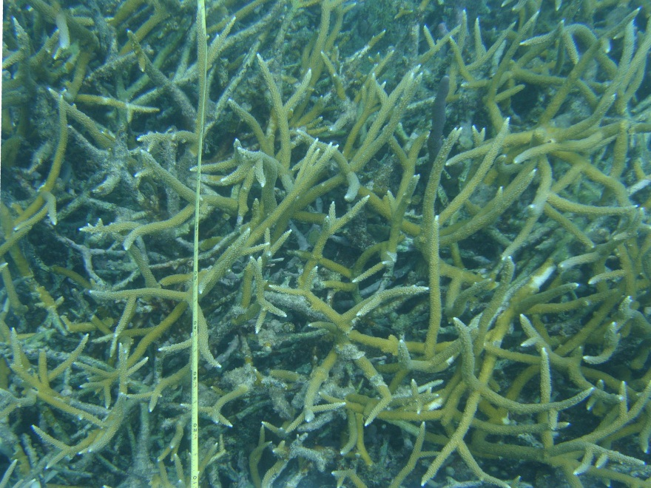
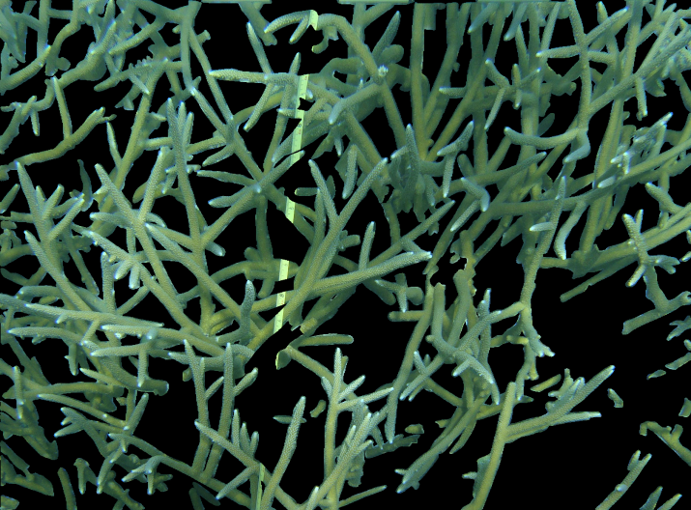
Experimental Setup
62 quadrat images
Leave-one-out
Each image/seg implies SVM classifier.
Use closest in average QF
SVM

Slide 6
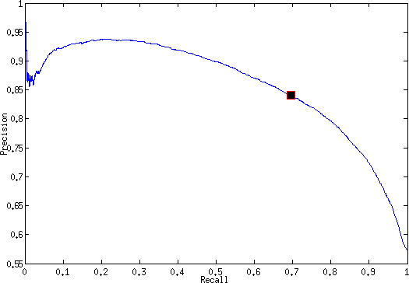
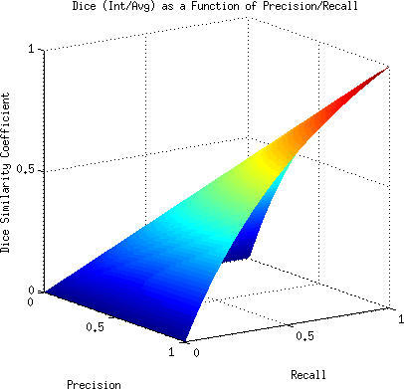
Validation
Average Precision (AP) – area under the Precision/Recall curve
Biased (not infinitely many negatives)
Dice Similarity Coefficient (DSC) – intersection with manual, divided by average.
Example PR curve
DSC vs. PR

Slide 7
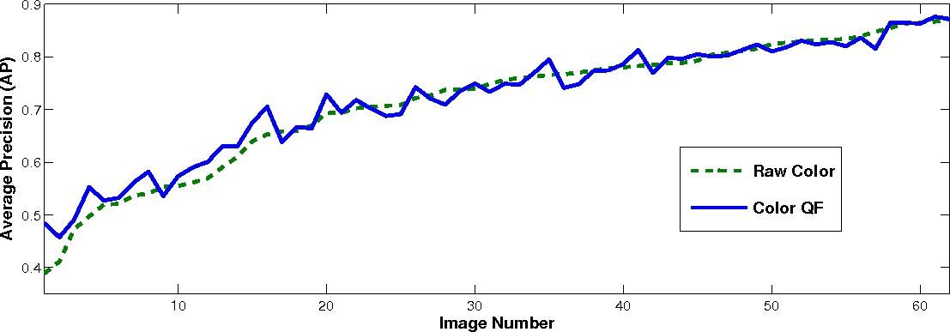
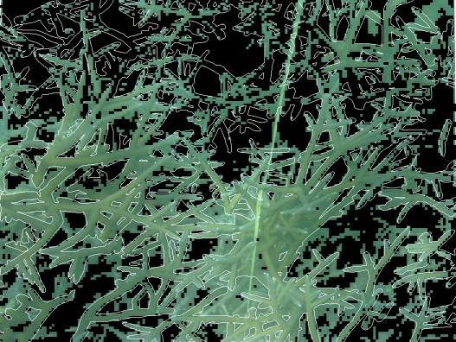
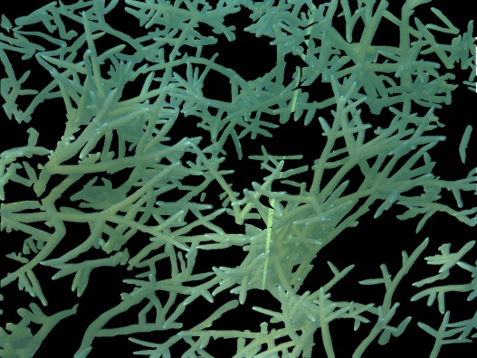
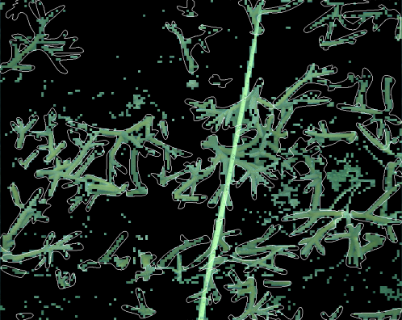
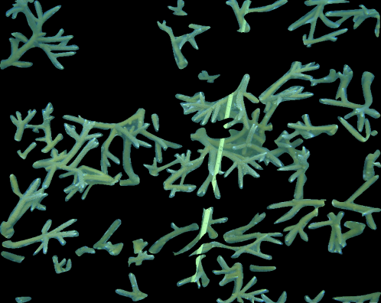
Results
AP: .721 QFs (vs .714 raw)
Figure: better by more, more often
DSC: 63.8% overall

Slide 8
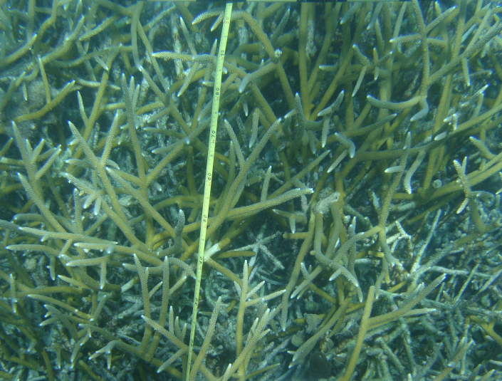
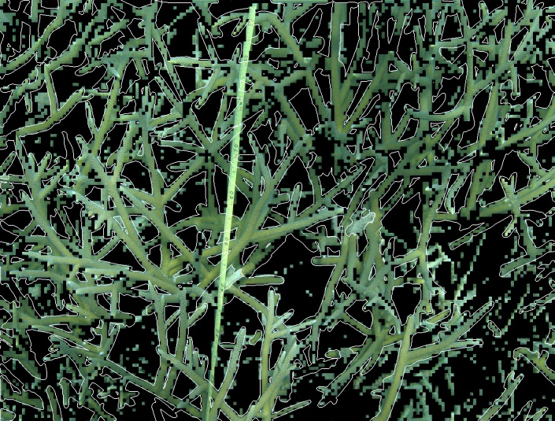
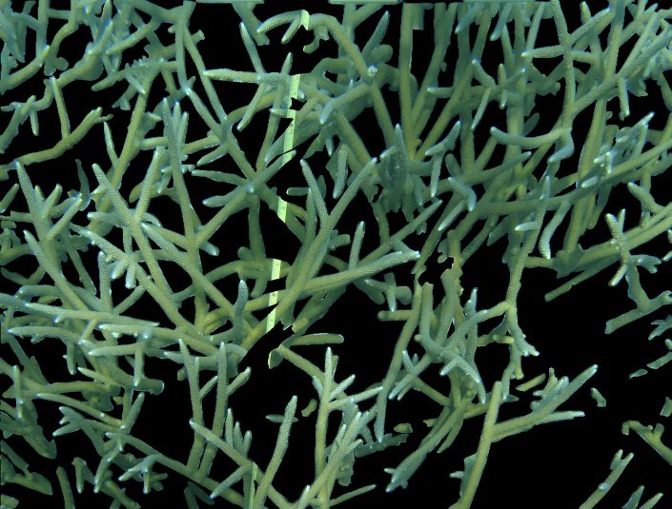
Traversing the PR Curve

Slide 9
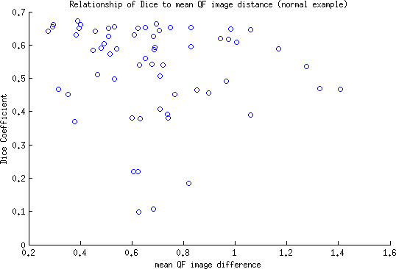
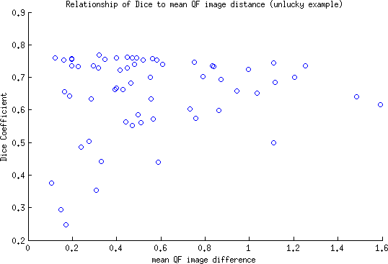
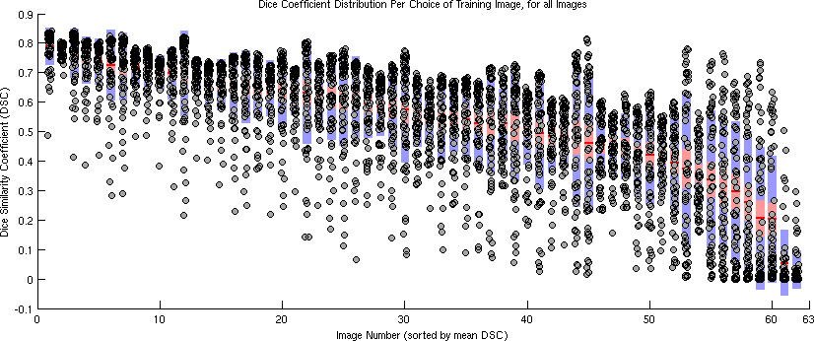
Future: Training Image Choice
Average QF distance is poor predictor
Image choice matters less than anticipated
Normal: closest image provides good training
Unlucky: closest image provides poor training
Distribution of DSC over choice of training image, for all images

Slide 10
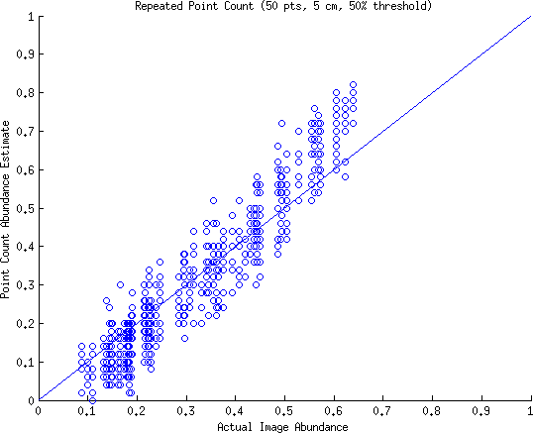
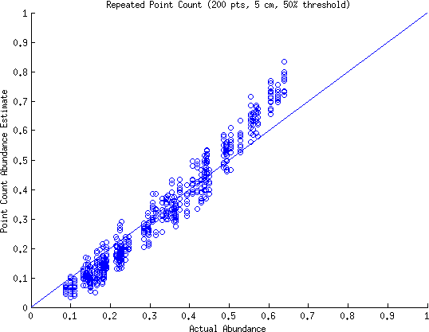
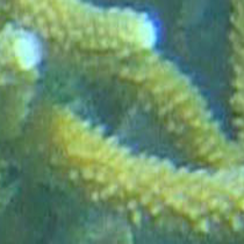
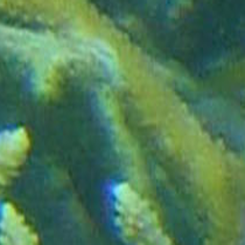
Point Counting
Point Counting is biased:
Number (of points)
Scale of decision
Benthic density
[Pante et al., 2012]
Experiment:
Manual segmentations as truth
Simulate abundance estimation under various point counting parameters
Example positive, negative, 5cm scale

Slide 11
Miscellanea
Better color normalization within/across images
Different color spaces
Boosting, different learners
Explore feature spaces, inform the above
Generalizability – separate training/val/test sets
Erratum: white balance
Thanks
Acquisition/segmentation, coauthors, William Sullivan
RE Lee and Lenfest institutional funds

Slide 12
More to do
-current, future directions: graph cuts, better color alignment across
regions or images, or a more local match. human interactive final
product to save time.
-point counting experiment, computer results showing bias (ref Pante
article). More forthcoming.
-erratum: white balance mention in paper.
-different color spaces experiment. This is closely tied to the color or contrast normalization across an image as well. Often the corners have different lighting conditions (off-angle diffuse), making them darker (especially the images are already quadrat-normalized, then they were already taken off-angle). Should look into color rep's that potentially account for that, or even some model of matte surfaces along with camera angle info discernable from the quadrat selection to normalize color. Maybe that's what NCC (normalized chromaticity coords) accomplishes. Or accounting for shadow.
-precision/recall curves, oooh with points on the curve corresponding to
segmentations on those contour images, like the last figure. I would be
cool to see it grow, hopefully in the right directions.
-test generalizability of method with separate training and test set,
maybe, rather than leave one out.
Adaboost with random forest learner

