Slide 1
CSCI 204: Data Structures & Algorithms
Revised by Xiannong Meng based on textbook author’s notes
Notes:
1

Slide 2
Quicksort
Revised based on textbook author’s notes.

Slide 3
Quick Sort
Uses a divide and conquer strategy to sort the keys stored in a sequence.
Pick a pivot in the sequence
Partition the sequence by dividing it into two segments based on a pivot key.
Uses subsequences without the need for temporary storage.
Quick sort is a recursive algorithm.

Slide 4
Quick Sort – Description
Select the first key as the pivot, p
Partition the sequence into segments L and G.
L contains all keys less than p
G contains all keys greater than or equal to p.
Recursively apply the same operation on L & G.
Continues until the sequence contains 0 or 1 key.
Merge the pivot and two segments back together.

Slide 5
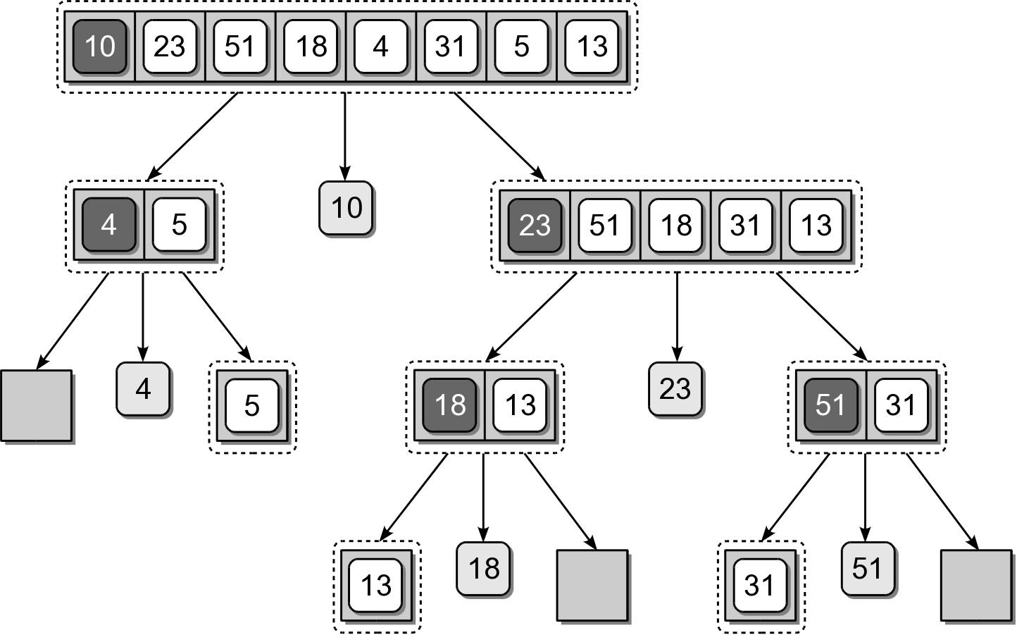
Quick Sort – Divide
Pick the first item, 10 as the pivot
Split the array into 2, based on pivot
Repeat …

Slide 6
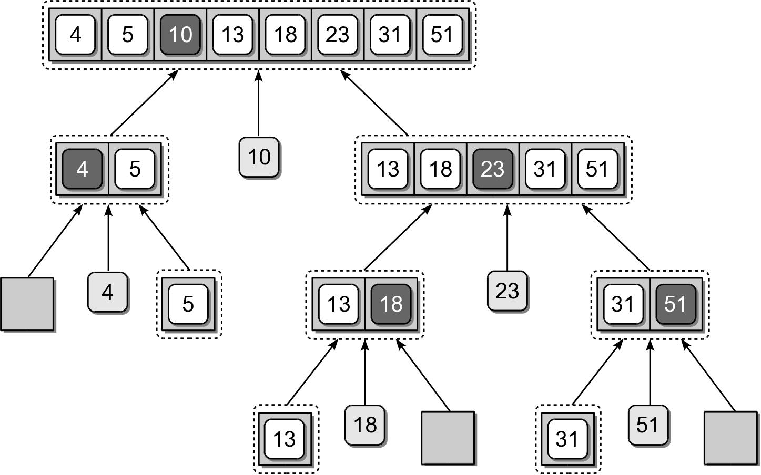
Quick Sort – Merge
Merge the sorted portions in reverse order

Slide 7
Quick Sort – Implementation
An efficient solution can be designed.
def quickSort( theSeq ):
n = len( theSeq )
recQuickSort( theSeq, 0, n-1 )
def recQuickSort( theSeq, first, last ):
if first >= last :
return
else :
# Partition the sequence and obtain the pivot position.
pos = partitionSeq( theSeq, first, last )
# Repeat the process on the two subsequences.
recQuickSort( theSeq, first, pos - 1 )
recQuickSort( theSeq, pos + 1, last )

Slide 8
Quick Sort – Partition
The partitioning step can be done without having to use temporary storage.
Rearranges the keys within the sequence structure.
The pivot will be in its correct position within the sequence.
Position of the pivot indicates the position where the split occurred.

Slide 9
Quick Sort – Partition
For illustration, we step through the first complete partitioning.
Pivot value is the first key in the segment.
Two markers (left and right) are initialized.
The markers will be shifted left and right until they cross each other.

Slide 10
Quick Sort – Partition
The left marker is shifted right until a key value larger than the pivot is found.
The right marker is then shifted left until a key value less than the pivot is found.

Slide 11
Quick Sort – Partition
The two keys at the positions of the left and right markers are swapped.

Slide 12
Quick Sort – Partition
The two markers are again shifted starting where they left off.

Slide 13
Quick Sort – Partition
After the markers are shifted, the corresponding keys are swapped as before.

Slide 14
Quick Sort – Partition
The shifting and swapping continues until the two markers cross each other.

Slide 15
Quick Sort – Partition
When the two markers cross, the right marker indicates the final position of the pivot value.
The pivot value and the value at the right marker have to be swapped.

Slide 16
Quick Sort – Partition
def partitionSeq( theSeq, first, last ):
pivot = theSeq[first]
left = first + 1
right = last
while left <= right :
while left < right and theSeq[left] < pivot :
left += 1
while right >= left and theSeq[right] >= pivot :
right -= 1
if left < right : # swap the items at left and right
tmp = theSeq[left]
theSeq[left] = theSeq[right]
theSeq[right] = tmp
if right != first : # put the pivot in its final place
theSeq[first] = theSeq[right]
theSeq[right] = pivot
return right

Slide 17
Pivot Key
We are not limited to selecting the first key within the sequence as the pivot.
Using the first or last key is a poor choice in practice.
Choosing a key near the middle is a better choice.

Slide 18
Quick Sort – Efficiency
The quick sort algorithm:
has a worst case time of O(n²)
but an average case time of O(n log n)
It does not require additional storage (in-place).
Commonly used in language libraries.
Earlier versions of Python used quick sort.
Current versions use a hybrid that combines the insertion and merge sort algorithms.

