Slide 1
CSCI 204: Data Structures & Algorithms
Revised by Xiannong Meng based on textbook author’s notes
Notes:
1

Slide 2
Binary Tree Implementation
Revised based on textbook author’s notes.

Slide 3
Binary Tree Implementation
Many different implementations. We’ll discuss two.
Linked node based
Array based

Slide 4
Linked node based
# The storage class for creating binary tree nodes.
class BinTreeNode :
def __init__( self, data ):
self.data = data
self.left = None
self.right = None
def set_left(self, leftnode):
”””Set the incoming node as the left child”””
self.left = leftnode
”””similar functions follow”””
def set_right(self, rightnode):
def set_data(self, new_data):
def get_data(self):
def get_left(self):
def get_right(self):
bintreenode.py

Slide 5
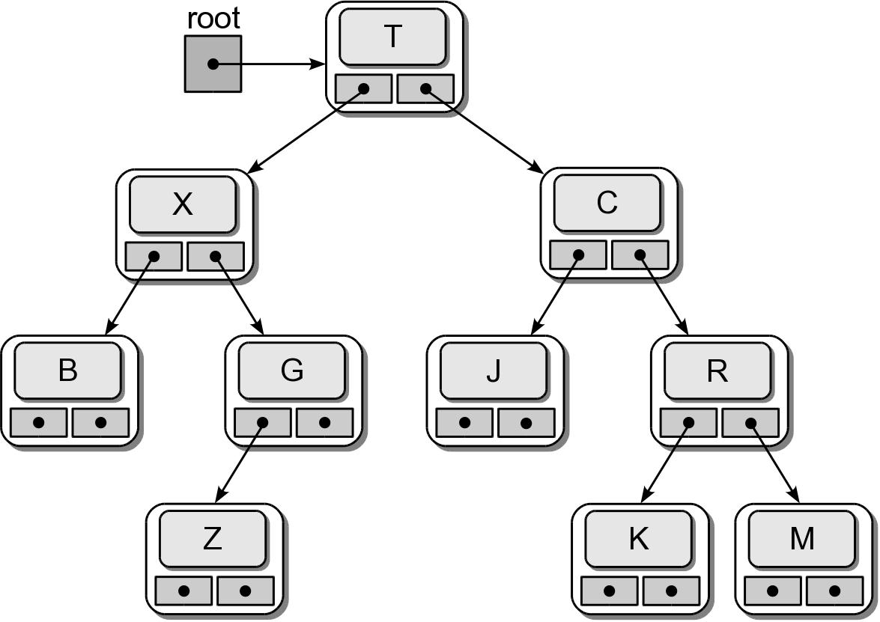
Physical Implementation
testbintree.py

Slide 6
Tree Traversals
Iterates through the nodes of a tree, one node at a time in order to visit every node.
With a linear structure this was simple.
How is this done with a hierarchical structure?
Must begin at the root node.
Every node must be visited.
Typically results in a recursive solution.

Slide 7
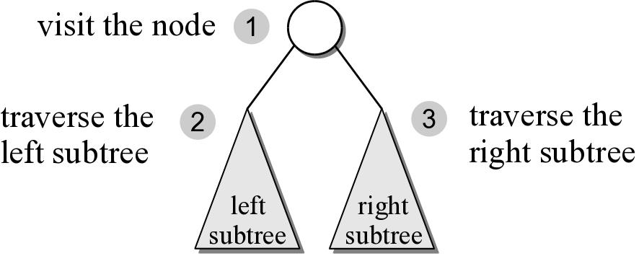
Preorder Traversal
After visiting the root,
traverse the nodes in the left subtree
then traverse the nodes in the right subtree.

Slide 8
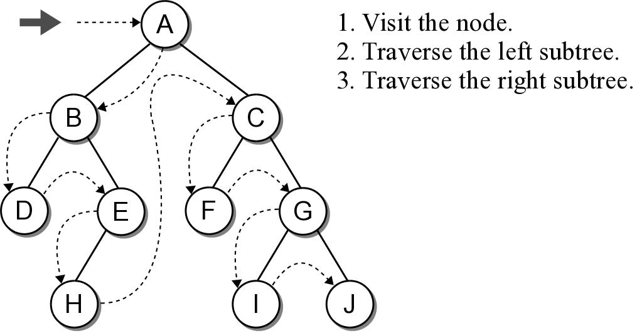
Preorder Traversal

Slide 9
Preorder Traversal
The implementation is rather simple.
Given a binary tree of size n, a complete traversal requires O(n) to visit every node.
def preorderTrav( subtree ):
if subtree is not None :
print( subtree.data )
preorderTrav( subtree.left )
preorderTrav( subtree.right )

Slide 10
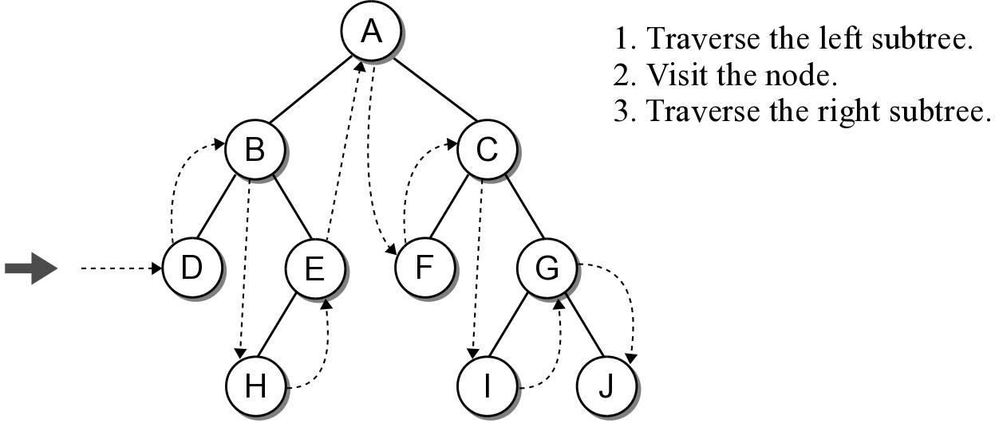
Inorder Traversal
Similar to the preorder traversal, but we traverse the left subtree before visiting the node.

Slide 11
Inorder Traversal
The implementation swaps the order of the visit operation and the recursive calls.
def inorderTrav( subtree ):
if subtree is not None :
inorderTrav( subtree.left )
print( subtree.data )
inorderTrav( subtree.right )

Slide 12
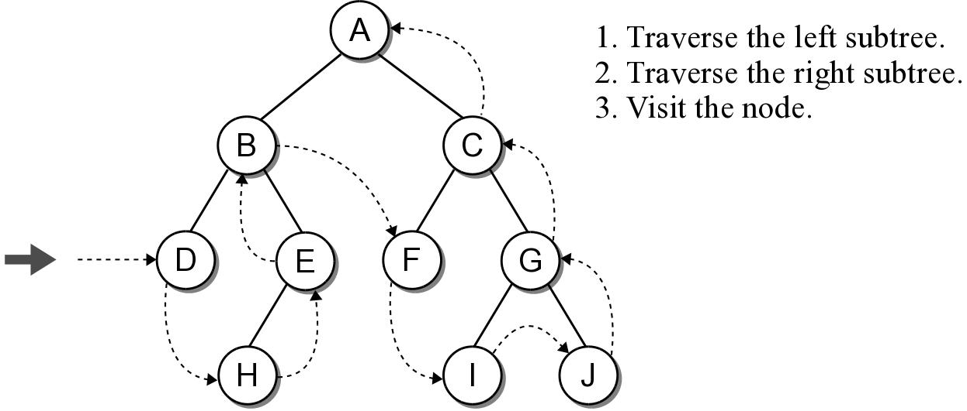
Postorder Traversal
Is the opposite of the preorder traversal.
Traverse both the left and right subtrees before visiting the node.

Slide 13
Postorder Traversal
The implementation swaps the order of the visit operation and the recursive calls.
def postorderTrav( subtree ):
if subtree is not None :
postorderTrav( subtree.left )
postorderTrav( subtree.right )
print( subtree.data )

Slide 14
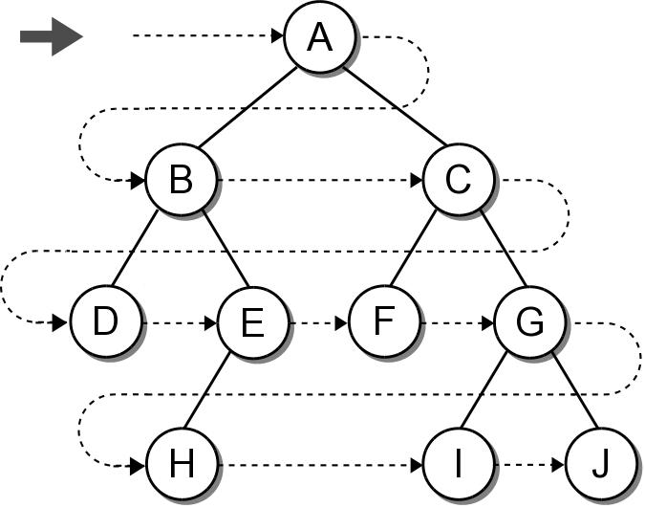
Breadth-First (level order) Traversal
The nodes are visited by level, from left to right. (a.k.a. level-order traversal)
The previous traversals are all depth-first traversals.

Slide 15
Breadth-First Traversal
Recursion can not be used with this traversal.
We can use a queue and an iterative loop.
def breadthFirstTrav( bintree ):
Queue q
q.enqueue( bintree )
while not q.isEmpty() :
# Remove the next node from the queue and visit it.
node = q.dequeue()
print( node.data )
# Add the two children to the queue.
if node.left is not None :
q.enqueue( node.left )
if node.right is not None :
q.enqueue( node.right )

Slide 16
Array based binary trees
It is very natural to implement binary trees using linked nodes.
For binary tree that has “many” nodes, it may be more effective and efficient to implement it using an array!

