Slide 1
CSCI 204: Data Structures & Algorithms
Notes:
1

Slide 2
Priority Queue ADT
Revised based on textbook author’s notes.

Slide 3
Priority Queues
Some applications require the use of a queue in which items are assigned a priority.
higher priority items are dequeued first.
items with equal priority still follow FIFO.

Slide 4
Some Applications
Operating systems such as Linux use priority queues to manage their jobs (try e.g., the top command)
Simulations use priority queues to manage events to be simulated
All other FIFO queues, e.g., online shopping queues are special cases of priority queue, that is, time of arrival is the priority

Slide 5
The Priority Queue ADT
A priority queue is a queue in which each item is assigned a priority and items with a higher priority are removed before those with lower priority.
Integer values are used for the priorities.
Smaller integers have a higher priority. Other arrangements, such as larger values represent higher priority are possible.

Slide 6
The Operations
PriorityQueue() is_empty() len() enqueue( item, priority ) dequeue() peek()

Slide 7
Priority Queue Example
Consider the following code segment:
Q = PriorityQueue( 6 )
Q.enqueue( “purple”, 5 )
Q.enqueue( “black”, 1 )
Q.enqueue( “orange”, 3 )
Q.enqueue( “white”, 0 )
Q.enqueue( “green”, 1 )
Q.enqueue( “yellow”, 5 )

Slide 8
Priority Queue Implementation
How should the ADT be implemented. We must consider:
A priority must be associated with each item in the queue.
The next item to be dequeued is the item with the highest priority.
If multiple items have the same priority, those must be dequeued in a FIFO order.

Slide 9
Priority Queue Implementation
There can be many different implementations, we’ll consider three here
Textbook approach
Linked list
Bounded array with linked lists

Slide 10
1. Textbook approach
The priority queue is implemented as a Python list
The enqueue operation puts the item at the end of the queue (as in our FIFO queue)
The dequeue operation takes the item with the highest priority off the queue (note: the item could be anywhere in the queue!)

Slide 11
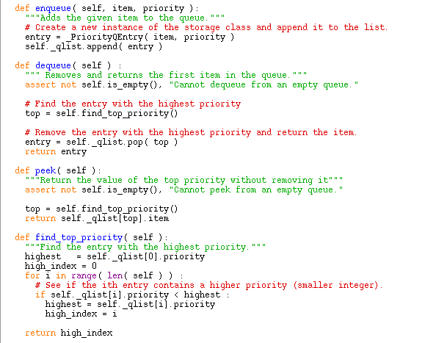
Queue operations
priorityq.py

Slide 12
Details of find_top_priority()
Basically it is the same process of finding a minimum in a list.
def find_top_priority(self):
highest_index = 0
highest = self._qlist[highest_index].priority
for i in range(len(self)):
if highest > self._qlist[i].priority: # smaller value has higher priority
highest_index = i
highest = self._qlist[i].priority
return highest_index
Try the program testpriorityqueue.py

Slide 13
Complexity of operations
What is the complexity for dequeue?
O(n)
What is the complexity for enqueue?
O(1)

Slide 14
2. Bounded Priority Queue
A bounded priority queue has a fixed set of priorities
We use an array to represent the set of priorities, each array element maintains a queue of the items with the same priority

Slide 15
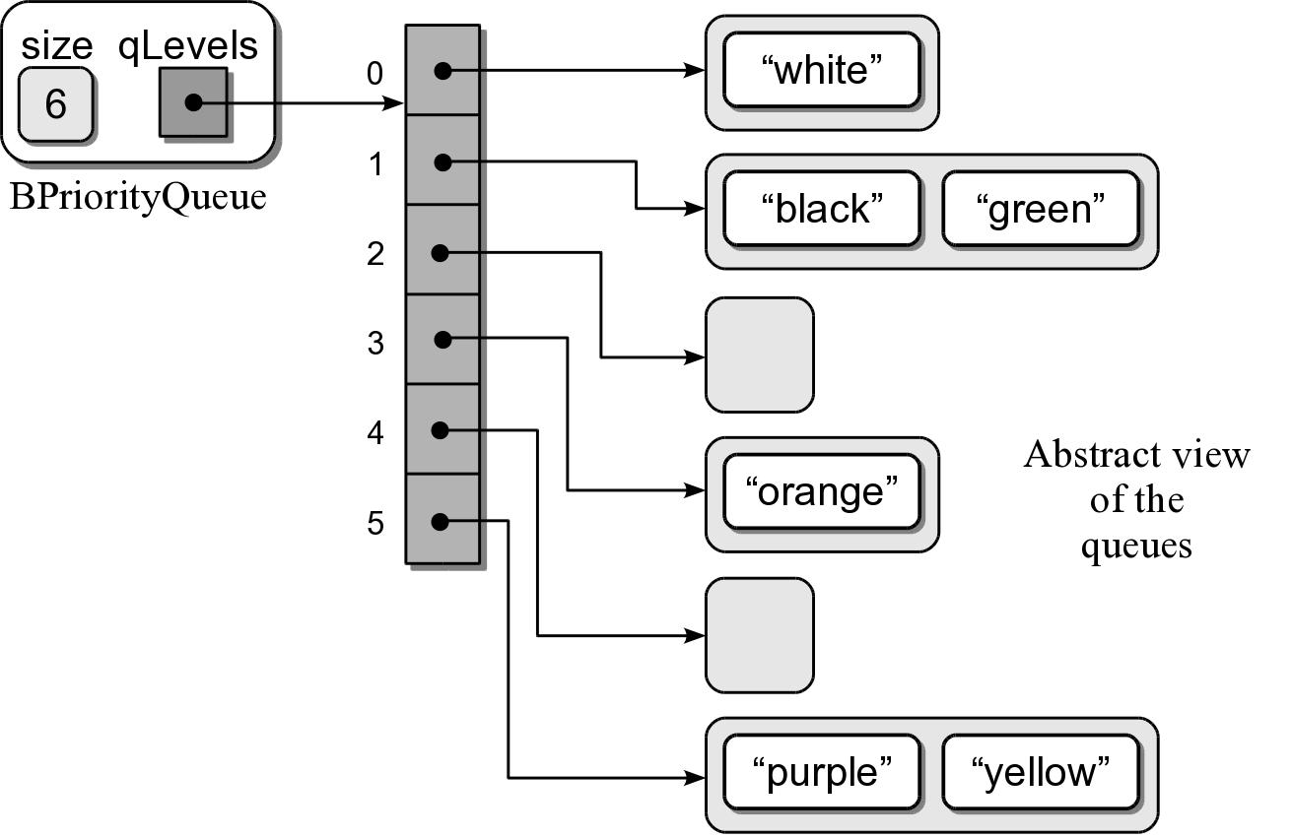
Bounded Priority Queue
The following example shows a bounded priority queue with six levels

Slide 16
Bounded Priority Q Implementation
bpriorityq.py
from array204 import Array
from llistqueue import Queue
class BPriorityQueue :
def __init__( self, num_levels = 6 ):
self._qsize = 0
self._qlevels = Array( num_levels )
for i in range( num_levels ) :
self._qlevels[i] = Queue()
def is_empty( self ):
return len( self ) == 0
def __len__( self ):
return len( self._qsize )
# ...

Slide 17
Bounded Priority Q Implementation
bpriorityq.py
class BPriorityQueue :
# ...
def enqueue( self, item, priority ):
assert priority >= 0 and priority < len(self._qlevels), \
"Invalid priority level."
self._qlevels[priority].enqueue( item )
def dequeue( self ) :
# Make sure the queue is not empty.
assert not self.is_empty(), "Cannot dequeue from an empty queue."
# Find the first non-empty queue.
top_index = self.find_top_priority_queue()
# We know the queue is not empty, so dequeue from the ith queue.
return self._qlevels[top_index].dequeue()

Slide 18
Bounded Priority Q Implementation
bpriorityq.py
class BPriorityQueue :
# ...
def find_top_priority_queue(self):
# find the first non-empty queue,
# a.k.a. highest priority
i = 0
p = len(self._qlevels)
while i < p and self._qlevels[i].is_empty() :
i += 1
return i

Slide 19
3. Unbounded Priority Q: Linked List
We can use a singly linked list:
Head and tail references.
Append new entries to the end.

Slide 20
Priority Queue Analysis
The worst case analysis for the two implementations.
Queue Operation | Python List | Linked List
q = PriorityQueue() | O(1) | O(1)
len(q) | O(1) | O(1)
q.is_empty() | O(1) | O(1)
q.enqueue(x) | O(n) | O(1)
x = q.dequeue() | O(n) | O(n)

Slide 21
3a. Unbounded Priority Q: Linked List
We can use a singly linked list:
Head and tail references.
Insert (enqueue) new item at the correct place
Remove (dequeuer) at the beginning of the queue.

Slide 22
Implement enqueue()
Your task is to implement the enqueue() method for a linked list based queue as in 3a in which other necessary methods have been implemented

