Slide 1
CSCI 204: Data Structures & Algorithms
Recursion 2
Notes:
1

Slide 2
Recursive binary search
Idea:
Compare the target with the list item in the middle
If found, stop;
If target is greater than the middle, search the second half, otherwise, search the first half
Base case(s):
Found or the list is exhausted
Recursive case:
Search the first half
Search the second half

Slide 3
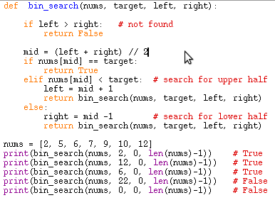
Recursive binary search

Slide 4
Check if a number is a prime
Ideas: to determine if b is a prime, we check if b % x == 0 (divisible) consecutively …
E.g., 5: we check 5%4, 5%3, 5%2, 5%1, when x reaches 1, we know 5 is a prime
E.g., 6: we check 6%5, 6%4, 6%3 which is 0, stop, 6 is not a prime

Slide 5
List all permutations
Make every element in the list as a prefix, one at a time, do it recursively
E.g., ‘abcd’
‘a’ + recursively(‘bcd’)
‘b’ + recursively(‘acd’)
‘c’ + recursively(‘abd’)
‘d’ + recursively(‘abc’)
Now let’s do the workshop.

Slide 6
The 8-Queens Problem
The task is to place 8 queens onto a chessboard such that no queen can attack another queen.
Uses a standard 8 x 8 chess board.
There are 92 solutions to this problem.

Slide 7
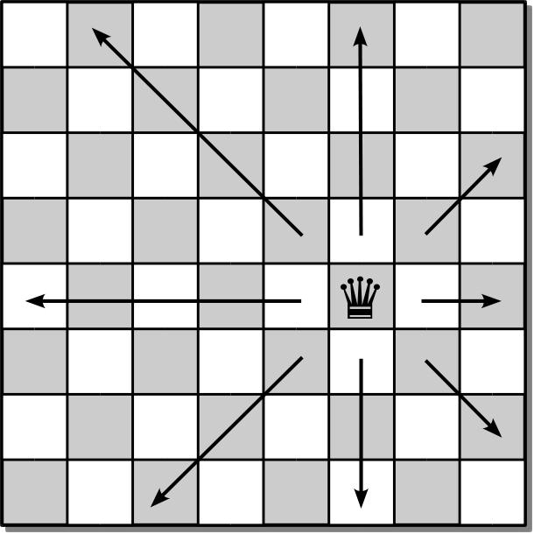
Queen’s Moves
The queen can move and attack any piece of the opponent by moving in any direction along a straight line.

Slide 8
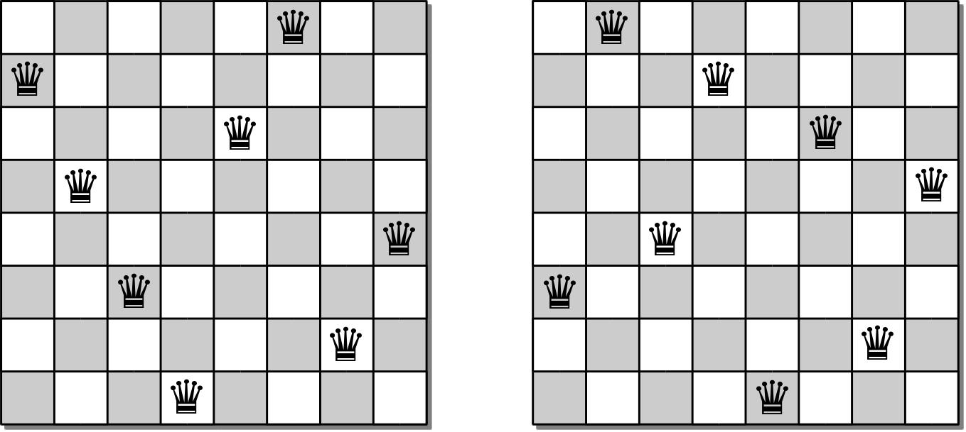
Sample Solutions

Slide 9
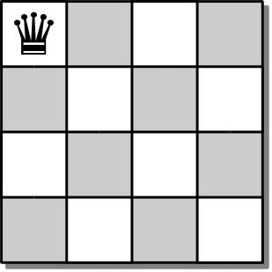
4-Queens Problem
To develop an algorithm, we consider the smaller 4-queens problem.
Since no two queens can occupy the same column, we can proceed one column at a time.
Place a queen in position (0, 0).

Slide 10
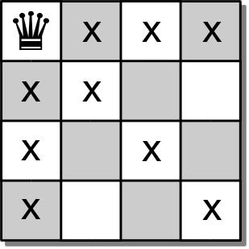
4-Queens Problem
This move eliminates a number of squares for the placement of additional queens.

Slide 11
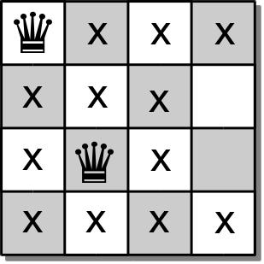
4-Queens Problem
We move to the second column and place a queen at position (2, 1)

Slide 12
4-Queens Problem
The 3rd queen should be placed in the 3rd column.
But there are no open cells in the third column.
So there is no solution based on the placement of the first 2 queens.

Slide 13
4-Queens Problem
We have to backtrack:
go back to the previous column
pickup the last queen placed
try to find another valid cell in that column.

Slide 14
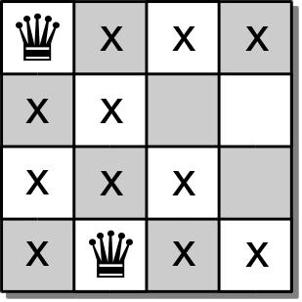
4-Queens Problem
Place a queen at position (3,1) and move forward.

Slide 15
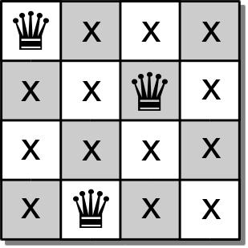
4-Queens Problem
In the 3rd column, we can now place a queen at position (1,2).
But now we have no open slots in the 4th column.

Slide 16
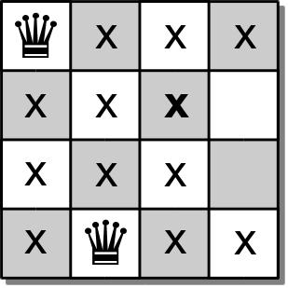
4-Queens Problem
We again must backtrack and pick up the queen from the 3rd column.
But there are no other empty cells in the 3rd column.

Slide 17
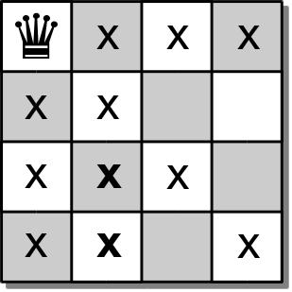
4-Queens Problem
We must backtrack yet again and pick up the queen from the 2rd column.
But there are no other empty cells in the 2nd column either.

Slide 18
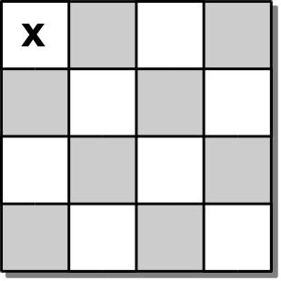
4-Queens Problem
So we backtrack one more time and pick up the queen from the 1st column.
We then try again to place a queen in the 1st column.

Slide 19
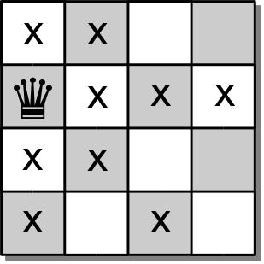
4-Queens Problem
In the 1st column, we can place a queen at position (1, 0).

Slide 20
4-Queens Problem
We again continue with the process and attempt to find open positions in each of the remaining columns.
We can use a similar approach to solve the original 8-queens problem.

Slide 21
N-Queens Board ADT
The n-queens board is used for positioning queens on a square board for use in solving the n-queens problem.
consists of n x n squares.
each square is identified by index [0...n)
NQueensBoard( n ) size() numQueens() unguarded( row, col ) | placeQueen( row, col ) removeQueen( row, col ) reset() draw()

Slide 22
8-Queens Solution
def solveNQueens( board, col ):
if board.numQueens() == board.size() :
return True
else :
for row in range( board.size() ):
if board.unguarded( row, col ):
board.placeQueen( row, col )
if board.solveNQueens( board, col+1 ) :
return True
else :
board.removeQueen( row, col )
return False

