Slide 1
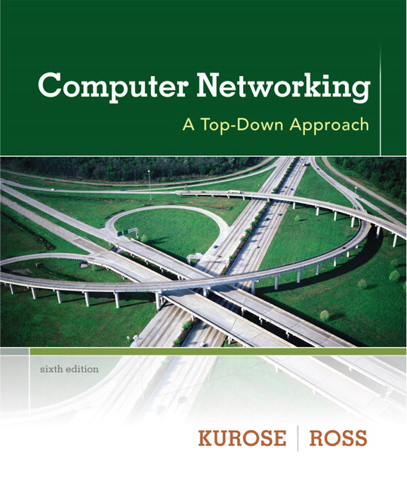
Chapter 4 Network Layer
A note on the use of these ppt slides:
We’re making these slides freely available to all (faculty, students, readers). They’re in PowerPoint form so you see the animations; and can add, modify, and delete slides (including this one) and slide content to suit your needs. They obviously represent a lot of work on our part. In return for use, we only ask the following:
Computer Networking: A Top Down Approach 6th edition Jim Kurose, Keith Ross Addison-Wesley March 2012
If you use these slides (e.g., in a class) that you mention their source (after all, we’d like people to use our book!)
If you post any slides on a www site, that you note that they are adapted from (or perhaps identical to) our slides, and note our copyright of this material.
Thanks and enjoy! JFK/KWR
All material copyright 1996-2012
J.F Kurose and K.W. Ross, All Rights Reserved
The course notes are adapted for Bucknell’s CSCI 363
Xiannong Meng
Spring 2016

Slide 2
Chapter 4: outline
4.1 introduction
4.2 virtual circuit and datagram networks
4.3 what’s inside a router
4.4 IP: Internet Protocol
datagram format
IPv4 addressing
ICMP
IPv6
4.5 routing algorithms
link state
distance vector
hierarchical routing
4.6 routing in the Internet
RIP
OSPF
BGP
4.7 broadcast and multicast routing

Slide 3
Interplay between routing, forwarding
routing algorithm determines
end-end-path through network
routing algorithm
forwarding table determines
local forwarding at this router
local forwarding table
dest address
output link
address-range 1
address-range 2
address-range 3
address-range 4
3
2
2
1
IP destination address in
arriving packet’s header
1
3
2

Slide 4
Graph abstraction
5
v
3
w
2
5
u
2
1
z
3
1
2
x
y
1
graph: G = (N,E)
N = set of routers = { u, v, w, x, y, z }
E = set of links ={ (u,v), (u,x), (v,x), (v,w), (x,w), (x,y), (w,y), (w,z), (y,z) }
aside: graph abstraction is useful in other network contexts, e.g.,
P2P, where N is set of peers and E is set of TCP connections

Slide 5
Graph abstraction: costs
5
c(x,x’) = cost of link (x,x’)
e.g., c(w,z) = 5
cost could always be simply be 1, or
inversely related to bandwidth,
or inversely related to
congestion
v
3
w
2
5
u
2
1
z
3
1
2
x
y
1
cost of path (x₁, x₂, x₃,…, x_{p}) = c(x₁,x₂) + c(x₂,x₃) + … + c(x_{p-1},x_{p})
key question: what is the least-cost path between u and z ?
routing algorithm: algorithm that finds that least cost path

Slide 6
Routing algorithm classification
Q: global or decentralized information?
global:
all routers have complete topology, link cost info
“link state” algorithms
decentralized:
router knows physically-connected neighbors, link costs to neighbors
iterative process of computation, exchange of info with neighbors
“distance vector” algorithms
Q: static or dynamic?
static:
routes change slowly over time
dynamic:
routes change more quickly
periodic update
in response to link cost changes

Slide 7
Chapter 4: outline
4.1 introduction
4.2 virtual circuit and datagram networks
4.3 what’s inside a router
4.4 IP: Internet Protocol
datagram format
IPv4 addressing
ICMP
IPv6
4.5 routing algorithms
link state
distance vector
hierarchical routing
4.6 routing in the Internet
RIP
OSPF
BGP
4.7 broadcast and multicast routing

Slide 8
A Link-State Routing Algorithm
Dijkstra’s algorithm
net topology, link costs known to all nodes
accomplished via “link state broadcast”
all nodes have same info
computes least cost paths from one node (‘source”) to all other nodes
gives forwarding table for that node
iterative: after k iterations, know least cost path to k dest.’s
notation:
c(x,y): link cost from node x to y; = ∞ if not direct neighbors
D(v): current value of cost of path from source to dest. v (‘D’ is for distance)
p(v): predecessor node along path from source to v
N': set of nodes whose least cost path definitively known

Slide 9
Dijsktra’s Algorithm
1 Initialization:
2 N' = {u}
3 for all nodes v
4 if v adjacent to u
5 then D(v) = c(u,v)
6 else D(v) = ∞
7
8 Loop
9 find w not in N' such that D(w) is a minimum
10 add w to N'
11 update D(v) for all v adjacent to w and not in N' :
12 D(v) = min( D(v), D(w) + c(w,v) )
13 /* new cost to v is either old cost to v or known
14 shortest path cost to w plus cost from w to v */
15 until all nodes in N'

Slide 10
Dijkstra’s algorithm: an example
Step
0
1
2
3
4
5
N'
u
ux
uxy
uxyv
uxyvw
uxyvwz
D(v),p(v)
2,u
2,u
2,u
D(w),p(w)
5,u
4,x
3,y
3,y
D(x),p(x)
1,u
D(y),p(y)
∞
2,x
D(z),p(z)
∞
∞
4,y
4,y
4,y
5
v
3
w
2
5
u
2
1
z
3
1
2
x
y
1

Slide 11
Dijkstra’s algorithm: example (2)
resulting shortest-path tree from u:
v
w
u
z
x
y
resulting forwarding table in u:
destination
link
v
(u,v)
x
(u,x)
y
(u,x)
w
(u,x)
z
(u,x)

Slide 12
Dijkstra’s algorithm: another example
D(v)
p(v)
D(w)
p(w)
D(x)
p(x)
D(y)
p(y)
D(z)
p(z)
Step
N'
0
u
7,u
3,u
5,u
∞
∞
1
2
3
4
5
x
9
notes:
construct shortest path tree by tracing predecessor nodes
ties can exist (can be broken arbitrarily)
5
7
4
8
u
3
w
y
z
2
3
7
4
v

Slide 13
Dijkstra’s algorithm: another example
D(v)
p(v)
D(w)
p(w)
D(x)
p(x)
D(y)
p(y)
D(z)
p(z)
Step
N'
0
u
7,u
3,u
5,u
∞
∞
1
uw
6,w
5,u
11,w
∞
2
uwx
6,w
11,w
14,x
3
uwxv
10,v
14,x
4
uwxvy
12,y
5
uwxvyz
x
9
notes:
construct shortest path tree by tracing predecessor nodes
ties can exist (can be broken arbitrarily)
5
7
4
8
u
3
w
y
z
2
3
7
4
v

Slide 14
Dijkstra’s algorithm, discussion
algorithm complexity: n nodes
each iteration: need to check all nodes, w, not in N
n(n+1)/2 comparisons: O(n²)
more efficient implementations possible (using min-heap as priority queue): O(nlogn)
oscillations possible:
e.g., suppose link cost equals amount of carried traffic:
A
A
A
A
1
1+e
2+e
0
0
2+e
2+e
0
D
B
D
B
D
B
D
B
0
0
1+e
1
0
0
1+e
1
0
C
e
0
0
1
0
0
1
C
C
1+e
C
1
e
Initially, all
zeros, when
B, C, D sends data
Into the network
given these costs,
find new routing….
resulting in new costs
given these costs,
find new routing….
resulting in new costs
given these costs,
find new routing….
resulting in new costs

